Slide 1

welcome

Slide 2

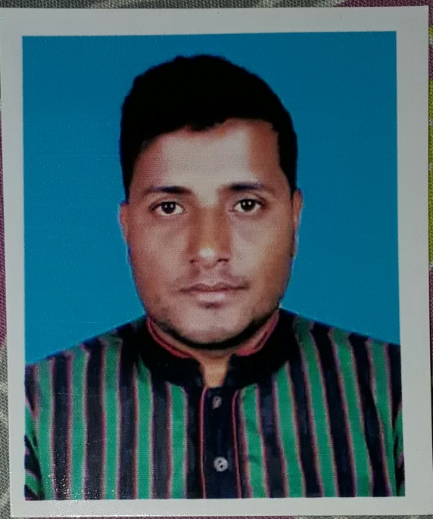
Introduction
Md Jakaria mahmud
Asst.Teacher
Chhotadamai high School Juri moulvibazar
jakariamahmud84@gmail.com

Slide 3

English For Today
Class :- Seven

Slide 4
Let us enjoy a video clip
What have you seen in the video?
Nearest friendship
We have seen two girls are performing more
What is the relation between them?
Nearest friendship means-

Slide 5
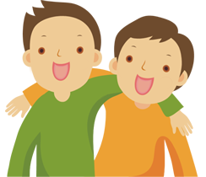
Our today’s lesson is-
The best friend

Slide 6
Learning Outcomes
By the end of the lesson we will be able to
ask and answer the questions.
talk about familiar events.
listen and understand the story.
write answers to questions.

Slide 7
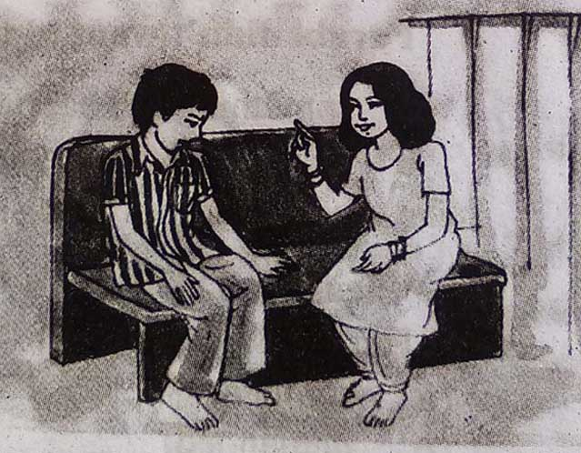
Talk about the pictures and familiar events
Farabi
Flora
Don’t be sad ,Farabi… I know a story, listen.

Slide 8
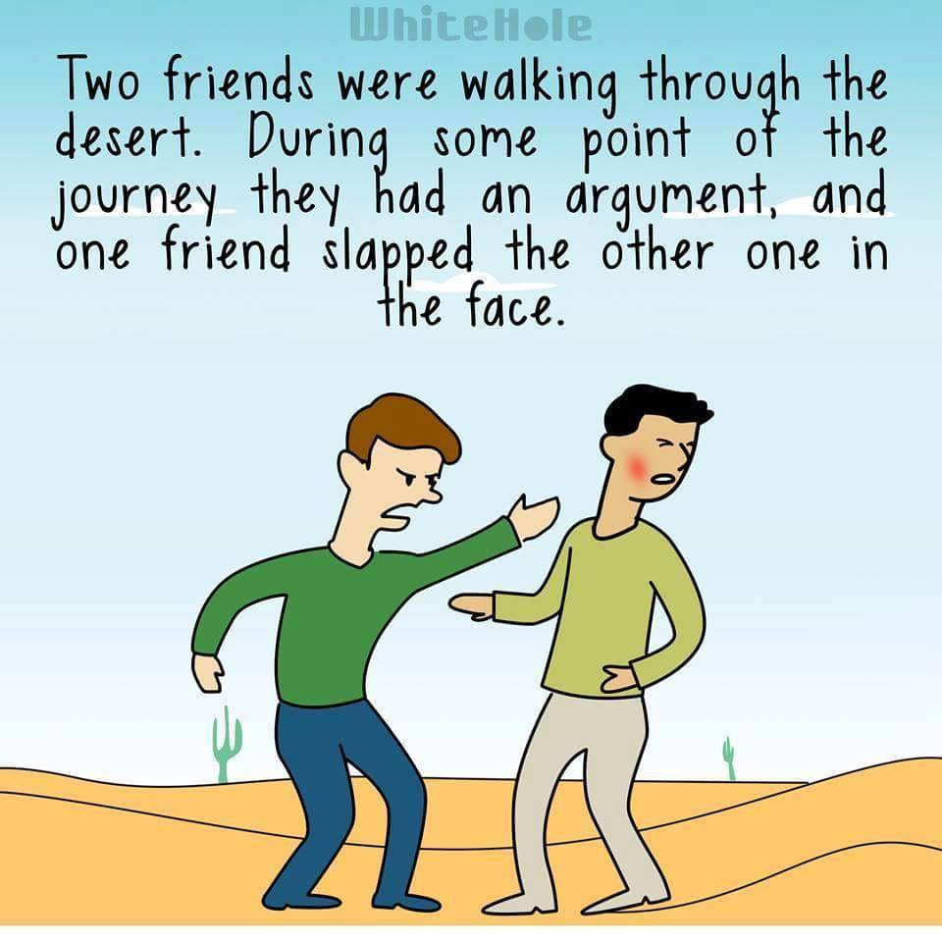

Slide 9
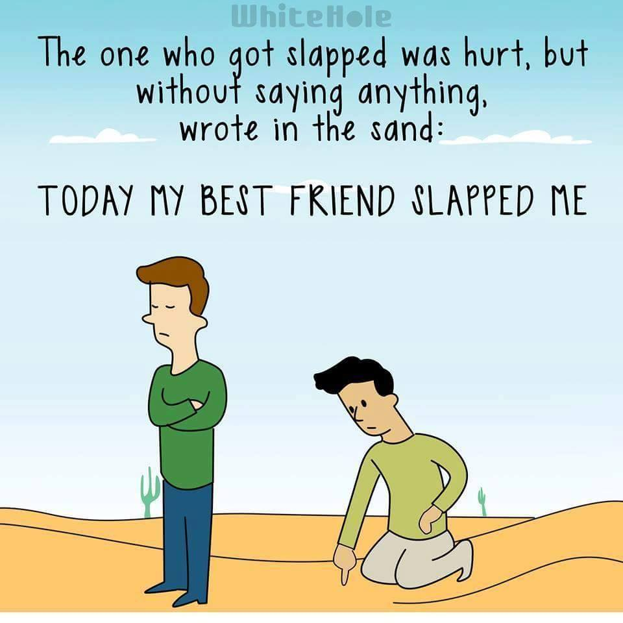

Slide 10
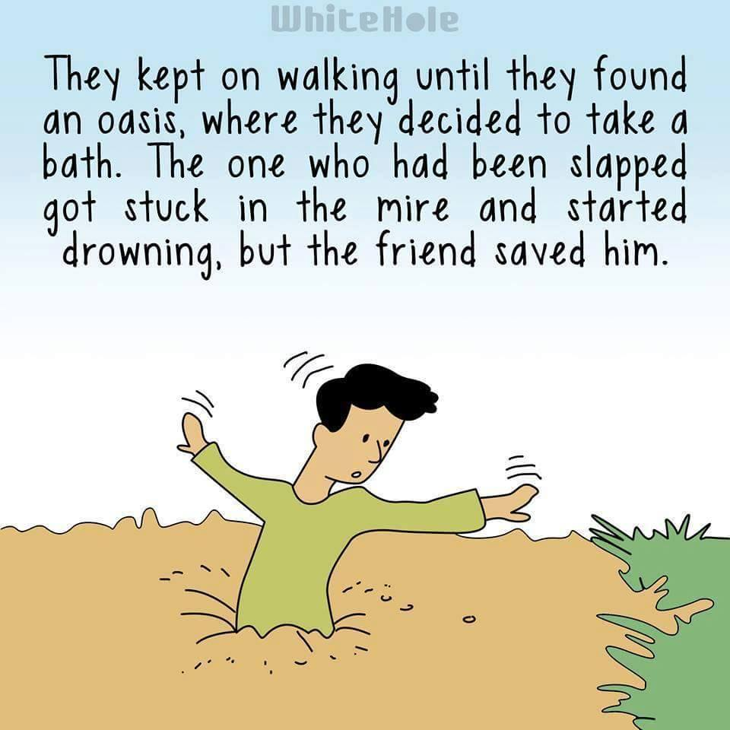

Slide 11
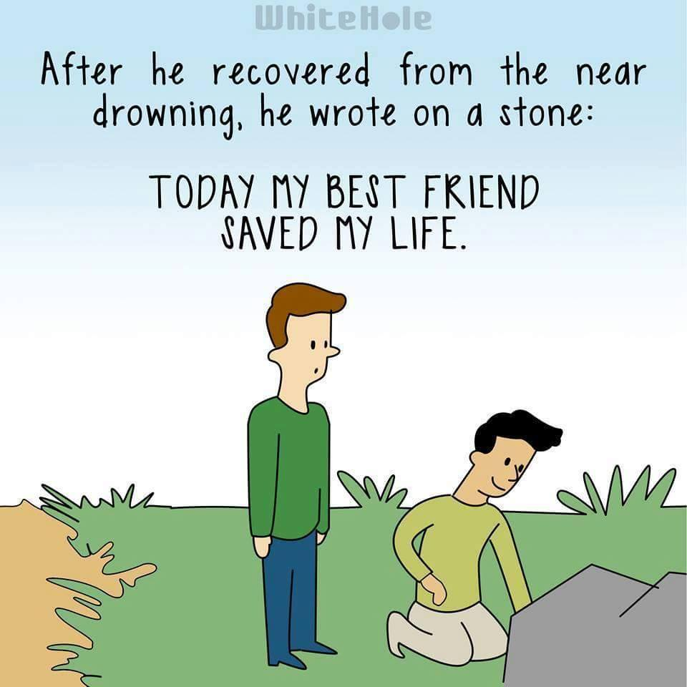

Slide 12

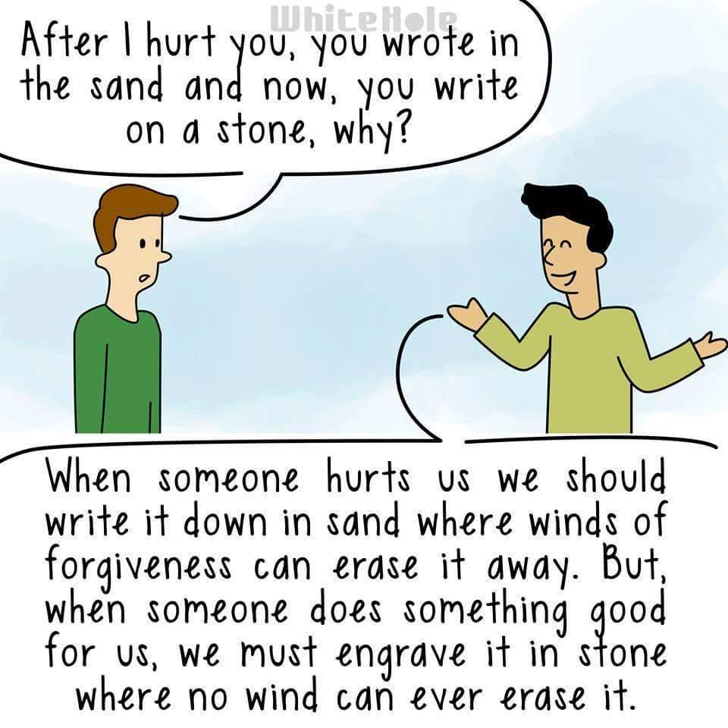

Slide 13
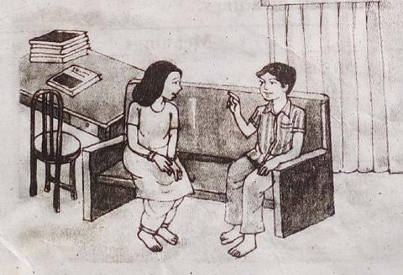
Do you know the moral of the story?
Yes, we should forget our hurts, but remember our good deeds forever.

Slide 14
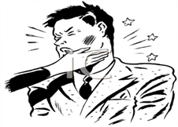
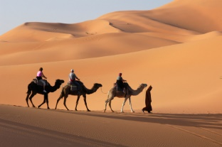
Let us know new words meaning.
slap
hit
oasis
waterhole

Slide 15
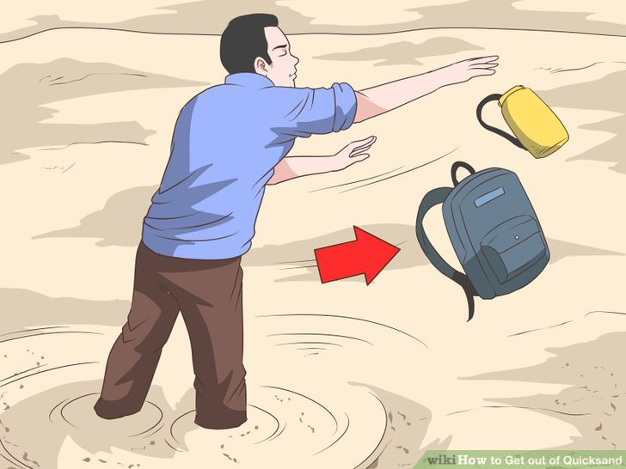
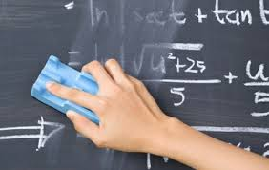
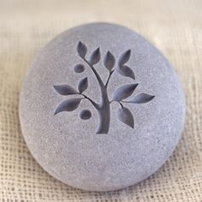
quicksand
Loose wet sand
erase
rub out
engrave
carve

Slide 16
Match the words/phrase with their meanings.
Words/ phrase | Meanings
1 hurt
a An area in a desert where there are water, plants, etc.
2 oasis
b remove something completely.
3 quicksand
c cut wood or designs on stone or wood.
4 erase
d got physical pain when someone hits you or you fall.
5 engrave
e deep wet sand that works like a trap.if you walk on it, you will sink into it.

Slide 17
Group Work
Group Work
Why should we forgive those who hurt us?

Slide 18
Evaluation
Where were the two friends walking?
What did Farabi do at the end of the story?
What is the moral lesson of the story?

Slide 19

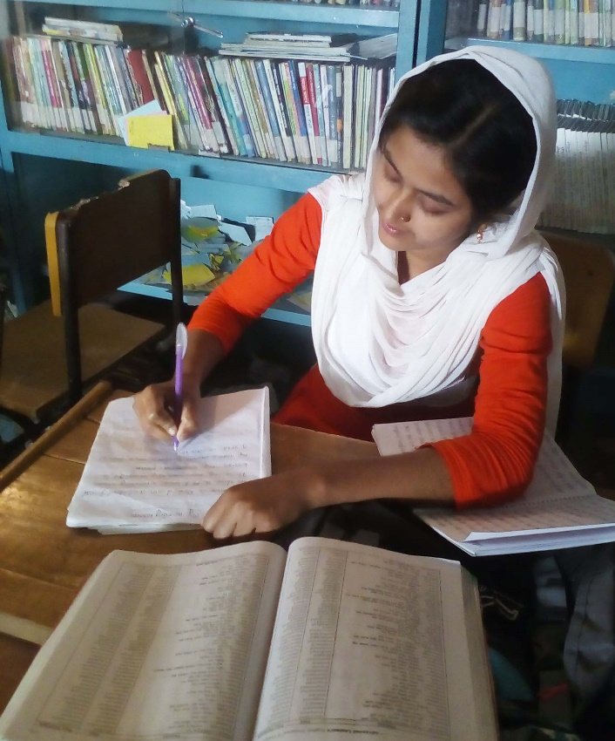
Home Work
Write an e-mail to your intimate
Friend to join a picnic.

Slide 20
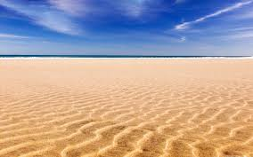
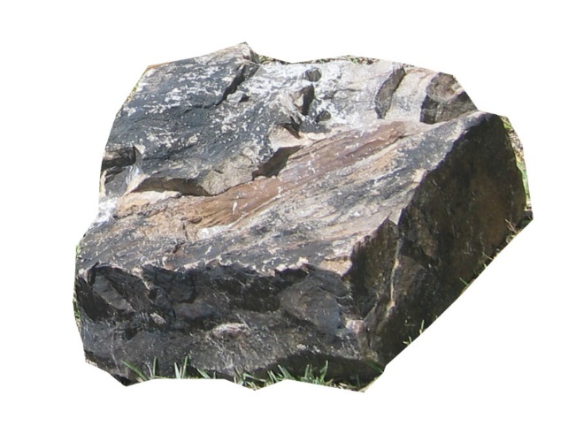
Thank you all
Write Your Hurts in the Sand
Carve Your Blessings in the Stone

